Slide 1
Introduction to Numpy
By
RAGE Uday Kiran

Slide 2
Overview
Numpy
ndarrays
n-dimensional arrays
indexing & Slicing
ndarray attributes
Joining function
numpy functions
Converting List into Numpy and vice versa
Converting Numpy into Dataframes and vice versa
Copies and Views

Slide 3
Numpy: Introduction
“Numpy” stands for Numerical Python.
Numpy is a standard python library which consists of multidimensional array objects and a collection of routines processing those arrays.
Using Numpy, mathematical and logical operations can be performed on arrays.
In Python, we have lists that serve the purpose of arrays, but they are very slow to process.

Slide 4
Numpy operations:
Mathematical and logical operations on arrays
Fourier transforms and routines for shape manipulation
Numpy has in-built functions for linear algebra and random number generations.

Slide 5
Numpy: Installing & Importing
Installing:
pip install numpy
Importing:
import numpy as np

Slide 6
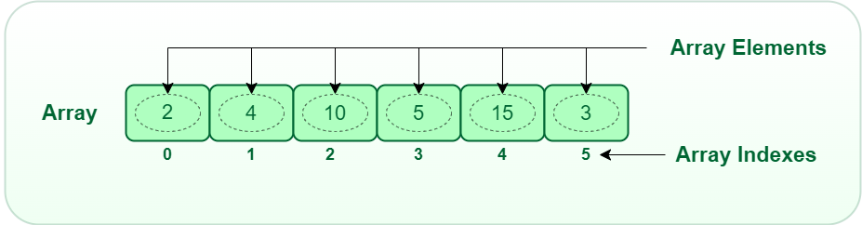
ndarray: Introduction to numpy arrays
The array data structure offered by numpy libraries is known as “ndarrays.”
Ndarrays is described as collection of items of the same type.

Slide 7

Declaring a numpy array:
numpy.array(object, dtype=None, copy=True, subok=False, ndmin=0)
import numpy as np
arr = np.array([1, 2, 3, 4, 5])
print(arr)

Slide 8
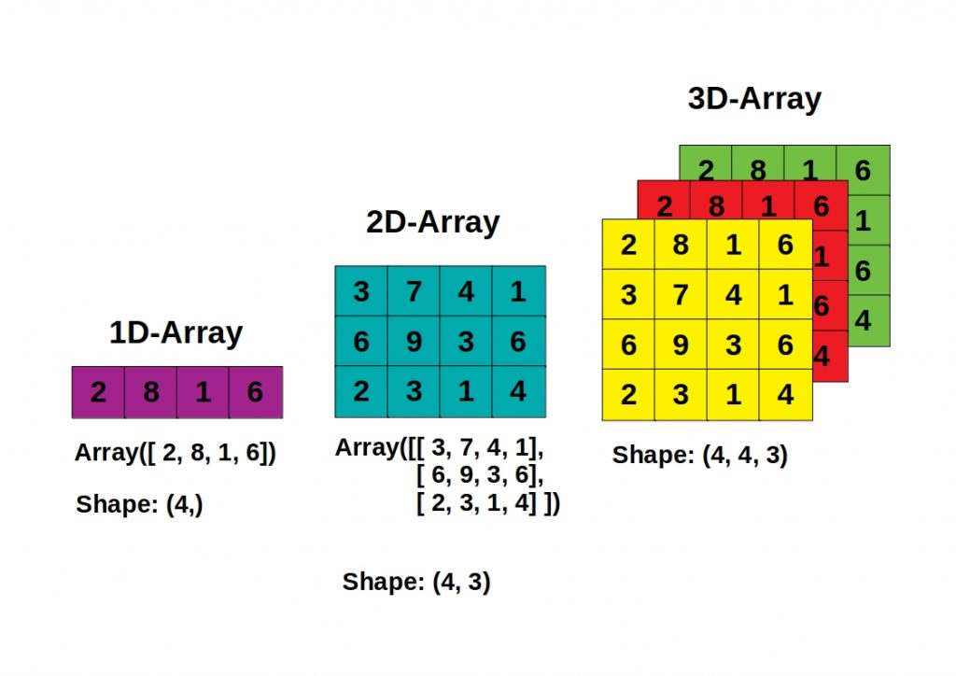
N-dimensional arrays

Slide 9
Dimensional Arrays: (1-D)
An array that has 0-D arrays as its elements is called uni-dimensional or 1-D arrays.
import numpy as np
arr = np.array([1, 2, 3, 4, 5])
print(arr)

Slide 10

Dimensional Arrays: (2-D)
An array that has 1-D arrays as its elements is called 2-D arrays.
import numpy as np
arr = np.array([[1, 2, 3], [4, 5, 6]])
print(arr)

Slide 11
Dimensional Arrays: (3-D)
An array that has 2-D arrays as its elements is called 3-D array.
Example: Creating 3-D array with 2-D arrays.
import numpy as np
arr = np.array([[[1, 2, 3], [4, 5, 6]], [[1, 2, 3], [4, 5, 6]]])
print(arr)

Slide 12

Checking number of dimensions in array
“Ndim” is a keyword to find the dimensions of array, and also can be used when creating the array.
import numpy as np
arr = np.array([1, 2, 3, 4], ndmin=5)
print(arr)
print('number of dimensions :', arr.ndim)

Slide 13

ndarray Indexing:
Ndarray can be accessed in the same way as python lists. The indexing of array start from (0 to n - 1), n is defined as length of array.
Example: 2D arrays can be accessed through index in 2 ways.
import numpy as np
arr = np.array([[1,2,3,4,5], [6,7,8,9,10]])
print('2nd element on 1st row: ', arr[0, 1])
print('2nd element on 1st row: ', arr[0][1])

Slide 14

Slicing arrays:
Slicing means taking elements from one given index to another given index.
We can pass the slice instead of index in two different ways:
[start:end]
[start:step:end]
import numpy as np
arr = np.array([1, 2, 3, 4, 5, 6, 7])
print(arr[1:5])
print(arr[4:])
print(arr[:4])
print(arr[-3:-1])
print(arr[1:5:2])
print(arr[::2])
Note: The default values of start, end, and step are 0, length of array, and 1 respectively.

Slide 15
Ndarray Attributes:
Attribute | Return
ndarray.shape | Returns a tuple consisting of array dimensions
ndarray.ndim | Returns the number of array dimensions
ndarray.dtype | Returns the data type of array
ndarray.size | Returns total number of elements in array
ndarray.itemsize | Return the size(in bytes) of each element of a Numpy array

Slide 16
Joining two arrays: using concatenate()
Putting arrays of two or more arrays in a single array.
import numpy as np
arr1 = np.array([1, 2, 3])
arr2 = np.array([4, 5])
arr = np.concatenate((arr1, arr2))
print(arr)

Slide 17
Joining two arrays: along rows & columns
Stacking is same as concatenation, the only difference is that stacking is done along a new axis.
We can concatenate two 1-D arrays along the second axis which would result in putting them one over the other, ie. stacking.
Along rows:
Along Columns:
import numpy as np
arr1 = np.array([1, 2, 3])
arr2 = np.array([4, 5, 6])
arr = np.hstack((arr1, arr2))
print(arr)
import numpy as np
arr1 = np.array([1, 2, 3])
arr2 = np.array([4, 5, 6])
arr = np.vstack((arr1, arr2))
print(arr)

Slide 18
Numpy Functions:
Name | Function
np.append(arr1, arr2) | Merging two arrays
np.reshape(arr, (2, 3)) | To reshape the array
np.sum(arr) | Returns the sum of all elements in array
np.random.randint(n) | To generate random integer between 0 to n
np.zeros(n) | To create array of size n with 0’s
np.where(condition) | To search for elements in array with a condition
np.transpose(arr) | To transpose the array

Slide 19
Numpy Functions:
Name | Function
np.mean(arr) | Returns the mean of all elements in array
np.unique(arr) | Returns unique elements in array
np.dot(arr1, arr2) | Performs the dot product of two matrices
np.empty([shape]) | Used to create an array without initializing the entries of given shape
np.sort(arr) | To sort all the elements in array

Slide 20
Converting List into Numpy:
Converting Numpy into List:
import numpy as np
l=np.array([1,2,3,4,5,6,7] )
a = np.tolist(l)
print(a)
import numpy as np
l=[1,2,3,4,5,6,7]
a = np.asarray(l)
print(a)

Slide 21

Converting Numpy into DataFrames:
import numpy as np
import pandas as pd
my_array = np.array([[11, 22, 33], [44, 55, 66]])
df = pd.DataFrame(my_array, columns = ['Column_A','Column_B','Column_C'])
print(df)

Slide 22

Converting DataFrames into Numpy:
import pandas as pd
# Initialize a DataFrame
df = pd.DataFrame([[11,22,33],[44, 55, 66]], columns=['a', 'b', 'c'])
arr = df.to_numpy()
print(arr)

Slide 23
NumPy – Copies & Views
While executing the functions, some of them return a copy of the input array, while some return the view.
When the contents are physically stored in another location, it is called Copy.
If on the other hand, a different view of the same memory content is provided, we call it as View.
Simple assignments do not make the copy of array object. Instead, it uses the same id() of the original to access it. So, any changing shape of one will change the shape of the other too.

Slide 24
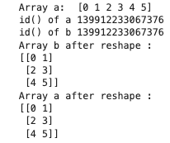
Example
import numpy as np Output :
a = np.arange(6)
print("Array a: ",a)
b = a
print("id() of a",id(a))
print("id() of b", id(b))
b.shape = 3,2
print("Array b after reshape : ")
print(b)
print("Array a after reshape : ")
print(a)

Slide 25
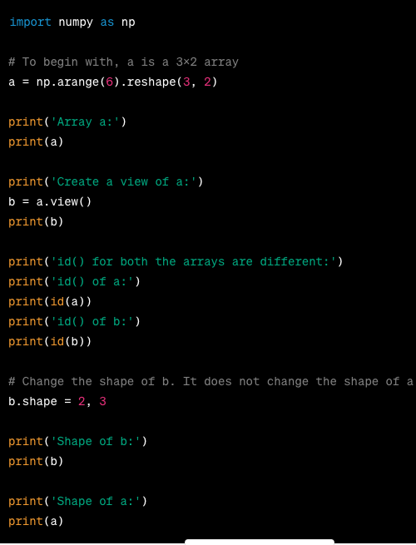
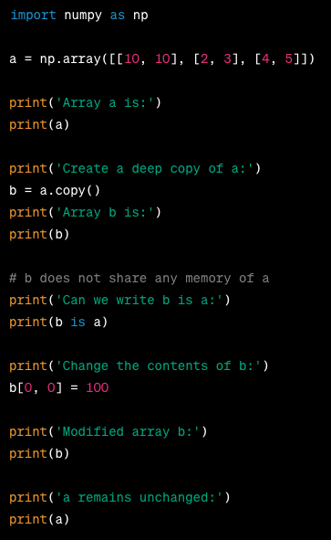
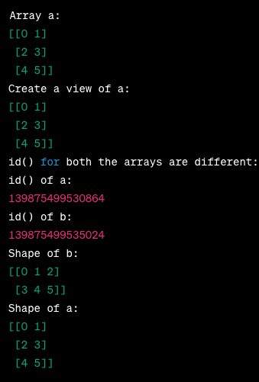
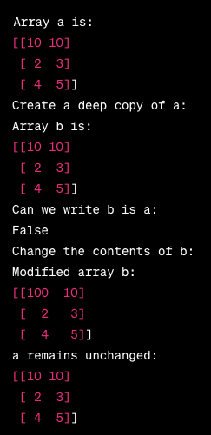
Deep Copy
Shallow Copy
NumPy has ndarray.view() method which is a new array object that looks at the same data of the original array. Unlike the earlier case, change in one doesnot effect other.
The ndarray.copy() function creates a deep copy. It is a complete copy of the array and its data and doesn’t share with the original array.
Output
Output

